Slide 1

Fake NEWS Project
Prepared by:
Akata Yadav

Slide 2
AGENDA
Introduction​
Problem Statement
Business Goal
Technical Requirement
Exploratory Data Analysis (EDA)
Data Description
Visualization
Data Pre-Processing
Build Model
Saved Best Model
Summary​

Slide 3
Introduction
Fake news's simple meaning is to incorporate information that leads people to the wrong path. Nowadays fake news spreading like water and people share this information without verifying it. This is often done to further or impose certain ideas and is often achieved with political agendas. For media outlets, the ability to attract viewers to their websites is necessary to generate online advertising revenue. So it is necessary to detect fake news.

Slide 4
Business Goal
Fake news has become one of the biggest problems of our age. It has serious impact on our online as well as offline discourse. One can even go as far as saying that, to date, fake news poses a clear and present danger to western democracy and stability of the society.

Slide 5
Technical Requirements
We need to build a machine learning model. But before model building do all data preprocessing steps involving NLP. Try different models with different hyper parameters and select the best model.
There are two datasets one for fake news and one for true news. In true news, there is 21417 news, and in fake news, there is 23481 news. We have to insert one label column zero for fake news and one for true news. We have to combine both datasets using pandas built-in function.
Follow the complete life cycle of data science. Include all the steps like:
1. Data Cleaning
2. Exploratory Data Analysis
3. Data Preprocessing
4. Model Building
5. Model Evaluation
6. Selecting the best mode

Slide 6
Exploratory Data Analysis (EDA)
Checked Top 5 rows of dataset
Checked Total Numbers of Rows and Column
Checked All Column Name
Checked Data Type of All Data
Checked for Null Values of both dataset
Added one more feature to distinguish between fake and true news by labelling
Merged both dataset
Dropped irrelevant features
Checked Information about Data

Slide 7
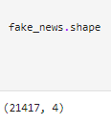
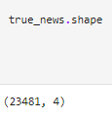
Data Description of Data-set
The fake_news dataset contains 21417 records (rows) and 4 features (columns)
The true_news dataset contains 23481 records (rows) and 4 features (columns)

Slide 8

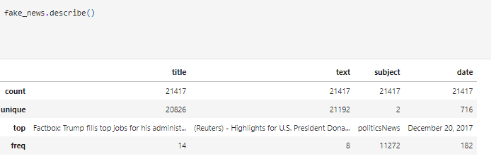
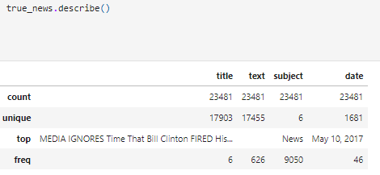

Slide 9

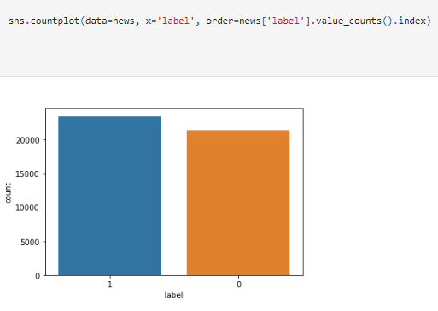
Data Visualization

Slide 10

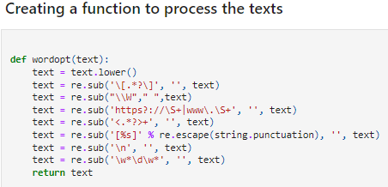

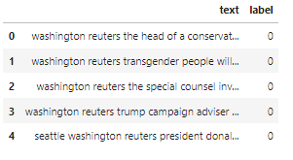


Slide 11



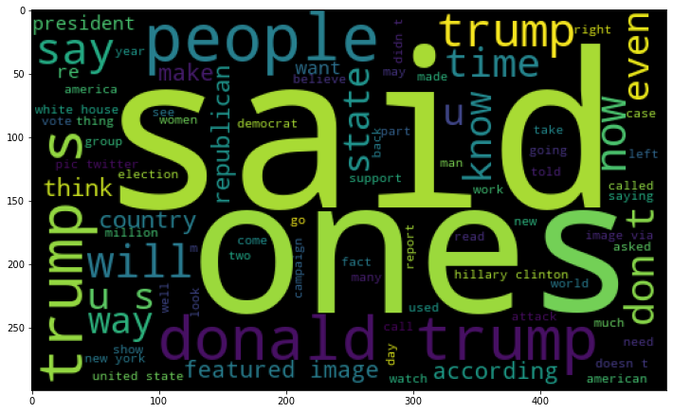
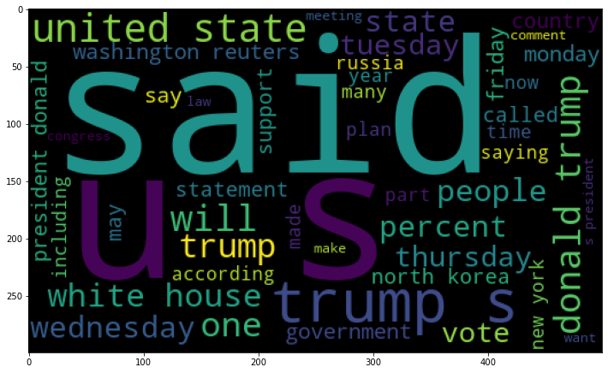

Slide 12


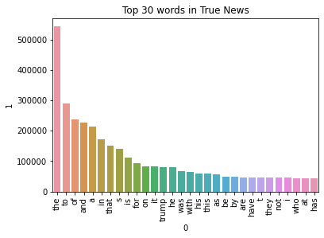

Slide 13

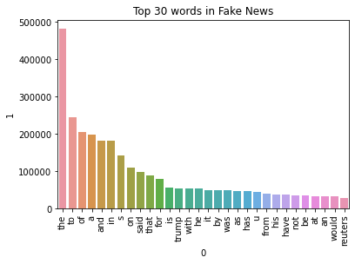

Slide 14
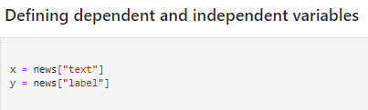
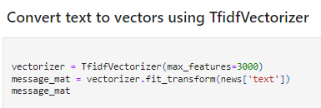



Slide 15
Hardware and Software Requirements and Tools Used
Hardware used:
Processor: 11th Gen Intel(R) Core (TM) i3-1125G4 @ 2.00GHz 2.00 GHz
System Type: 64-bit OS
Software used:
Anaconda for 64-bit OS
Jupyter notebook

Slide 16
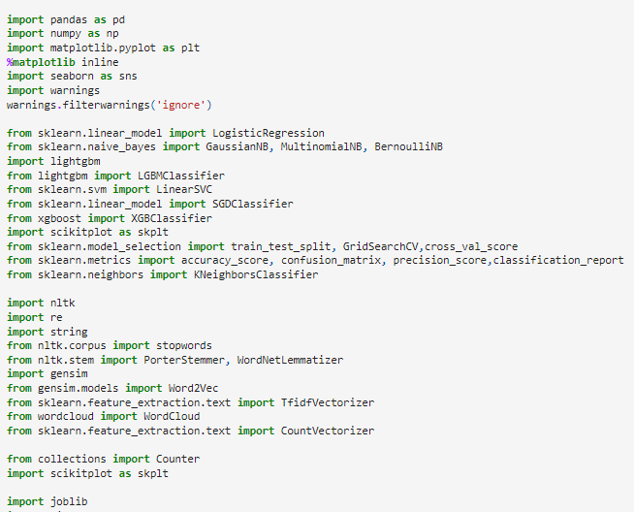

Tools, Libraries and Packages used:

Slide 17
Testing of Identified Approaches (Algorithms)
Logistic Regression
Decision Tree Classifier
Gradient Boosting Classifier
Random Forest Classifier
Linear Support Vector Classifier
Bernoulli NB
Multinomial NB
SGD Classifier
LGBM Classifier
XGB Classifier

Slide 18
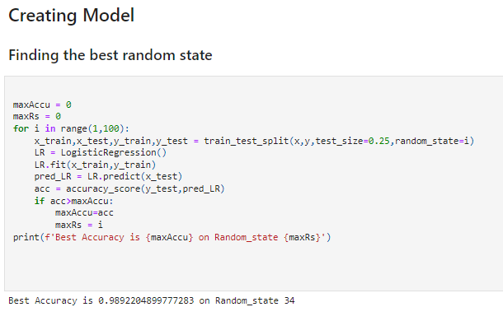

Slide 19
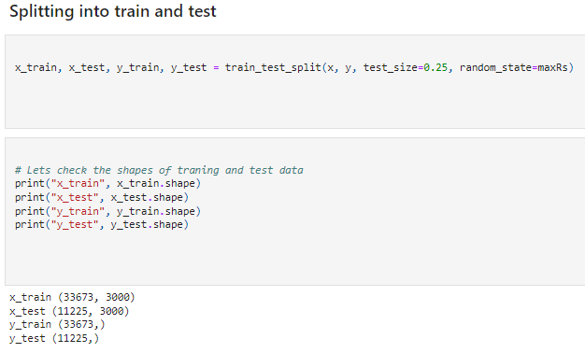

Slide 20
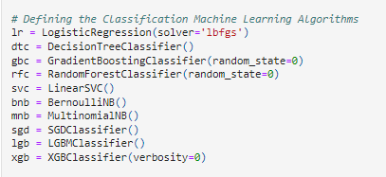
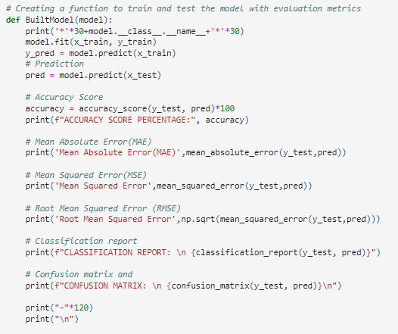

Slide 21
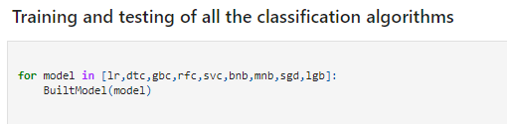
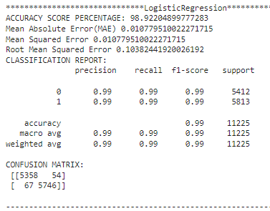
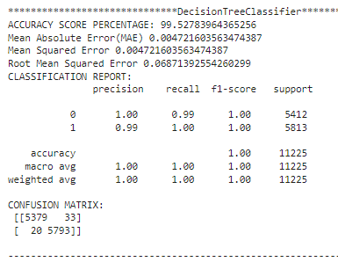

Slide 22
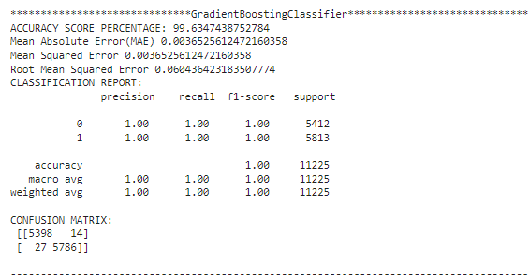
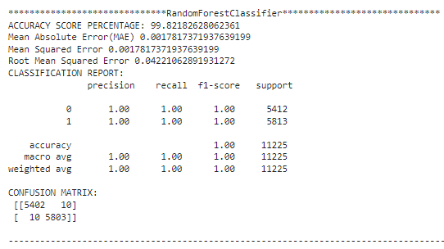

Slide 23
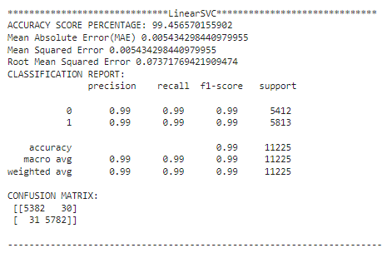
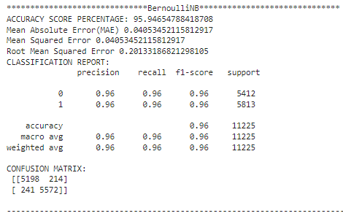

Slide 24
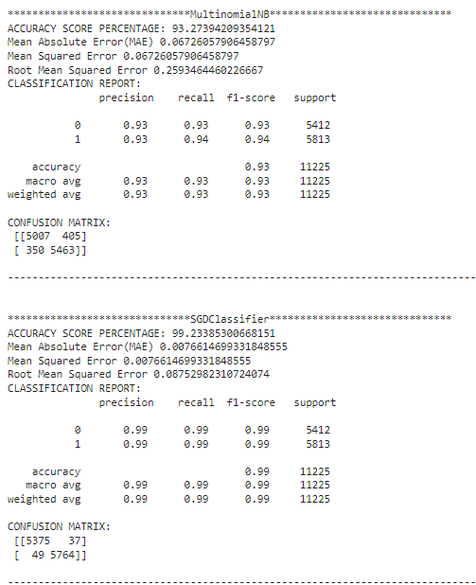
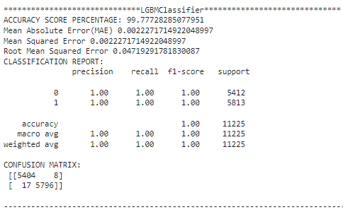

Slide 25
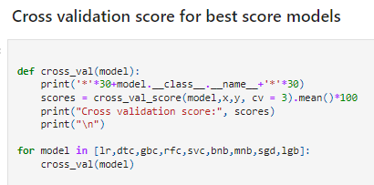
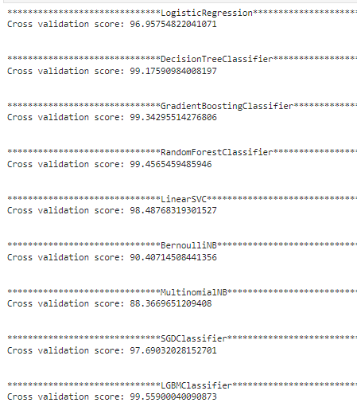

Slide 26
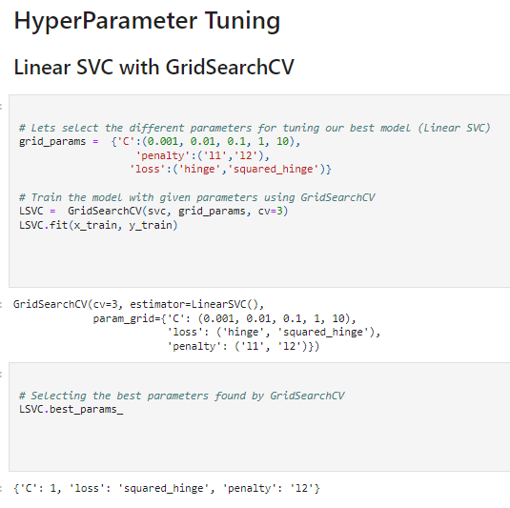

Slide 27
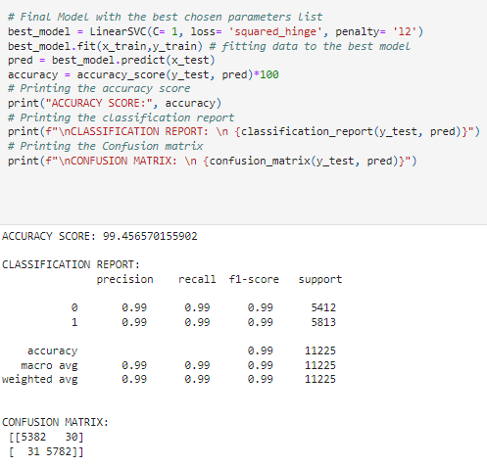
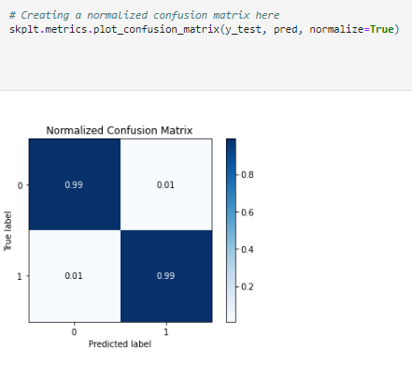

Slide 28

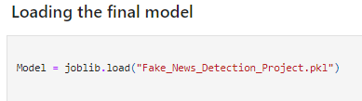
Final Procedure:
1. Saving the model

Slide 29
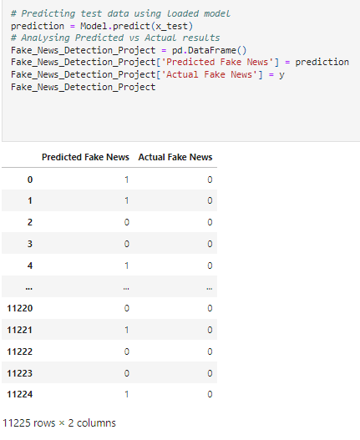
2. Comparing Actual and Prediction

Slide 30

3. Saving the model in CSV format

Slide 31
SUMMARY
In this project we have detected which news are fake news and which are true news. Then we have done different text process to eliminate problem of imbalance. By doing different EDA steps we have analyzed the text.
We have checked frequently occurring words in our data as well as rarely occurring words. After all these steps we have built function to train and test different algorithms and using various evaluation metrics we have selected Linear-SVC for our final model.
Finally, by doing hyperparameter tuning we got optimum parameters for our final model. And finally, we got improved accuracy score for our final model.

Slide 32
THANK YOU

